Slide 1
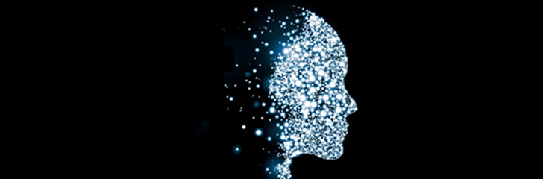
S/4HANA Machine Learning Workshop Bangalore, Shanghai, Walldorf Q3/2018
S/4HANA Architecture and Enablement, Palo Alto

Slide 2
Introduction to Machine Learning I
This 3-day training is for everyone interested in acquiring a good understanding of machine learning principles. We will cover the most important machine learning algorithms for supervised and unsupervised learning (including linear regression and multinomial logistic regression, decision trees and random forest (for both classification and prediction), support vector machines, k-means and hierarchical clustering as well as principle component analysis. (Additional algorithms may be covered if time permits.) Every algorithm will be explained in detail and participants should be able (at least in principle) to implement some of the algorithms on their own.
We will utilize Jupyter notebooks and the very popular Python-based Scikit-Learn for exercises and data visualization. Scikit-Learn provides a consistent framework for building end-to-end machine learning pipelines including various tools to evaluate the trained models. It is also supported by Leonardo ML.
After having gained a solid background in machine learning, we will contrast Scikit-Learn with HANA’s Predictive Analysis Library (PAL) and SAP Predictive Analysis.

Slide 3
Scalable Machine Learning II
Scalable Machine Learning and Introduction to Neural Networks
Many recent improvements in ML are attributed to the availability of large datasets and powerful distributed compute environments. Course participants will learn how to combine corporate data (stored in HANA) with large, public datasets (stored in Hadoop), and how to utilize the parallel machine learning algorithms that are available in Apache Spark ML and TensorFlow to train machine learning models in a Kubernetes-based compute cluster. The trained models can be applied from virtually any application either by submitting a job to a Spark cluster or via TensorFlow’s high-performance serving system.
Introduction to TensorFlow
Learn how to use TensorFlow to build simple classifiers (hands-on exercises). We will also cover (without exercises) how to use convolutional and recurrent neural networks to solve problems such as image recognition, text understanding, and time series forecasting. In addition to training machine learning models from scratch, we will describe so-called transfer learning which allows us to utilize complex pre-trained models as a starting point for training models in a much shorter period of time.

Slide 4
Agenda: Day 1
Introduction to Machine Learning and Machine Learning Concepts :
What is machine learning?
High-level classification of ML algorithms: Supervised learning, Unsupervised Learning, Reinforcement Learning (not covered in detail)
Machine Learning Principles
Overview of the training environment (Jupyter Notebooks) and Just Enough Python/NumPy (Hands-On)
Linear Regression
Algorithm
Closed Form and Stochastic Gradient Descent
Regularization: Ridge, Lasso, Elastic Net
Polynomial Regression

Slide 5
Agenda: Day 2
Classification
(Binomial) Logistic Regression
Cost Function
Gradient Descent
Multinomial Logistic Regression
Decision Trees
Ensemble Methods (not specific to decision trees)
Random Forest
Boosting/Bagging
Gradient-boosted Trees
XGBoost

Slide 6
Agenda: Day 3
Support Vector Machines (SVM)
Optimization Intuition
Large Margin Intuition
Kernels
Unsupervised Learning
K-Means Clustering
Hierarchical Clustering
Dimensionality Reduction: Principle Component Analysis (PCA)
Discussion: End-to-end ML pipeline at SAP

Slide 7
Agenda: Day 4
Scalable Machine Learning
Introduction to PySpark and Spark ML
Data Preparation
Data Pipelines in Spark
TensorFlow
Introduction to Neural Networks and Deep Learning
Introduction to Deep Learning
Logistic Regression as a Neural Network
Shallow Neural Network
Deep Neural Networks
Backpropagation
Hands-on: Implement a neural network from scratch

Slide 8
Agenda: Day 5
Introduction to TensorFlow
Basic Concepts: Graphs / Sessions
Hands-on: Simple Classification
Tensor Board
TensorFlow Serving
Convolutional NN
Recurrent NN
HANA and TensorFlow

Slide 9
Objectives
ML Concepts
Bias/variance, feature engineering, model evaluation, …
Selection of Algorithm(s)
Based on the distribution of data, number of records, number of features, features/records ratio, etc.
Model Deployment and Serving, Model Lifecycle Management

Slide 10
What is Machine Learning?

Slide 11
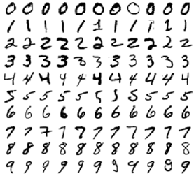
What is Machine Learning?
How would you write a program that can recognize digits?

Slide 12

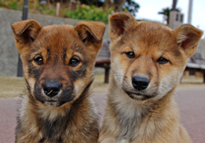
What is Machine Learning?
How would you write a program that can recognize digits?
How would you write a program that can distinguish between cats and dogs?

Slide 13
What is Machine Learning?
How would you write a program that can recognize digits?
How would you write a program that can distinguish between cats and dogs?
[Machine Learning is the] field of study that gives computers the ability to learn without being explicitly programmed. Arthur Samuel, 1959

Slide 14
What is Machine Learning?
"Programming computers to learn from experience should eventually eliminate the need for much of this detailed programming effort“
Samuel, A. L. (1959), “Some Studies in Machine Learning Using the Game of Checkers” in IBM Journal of Research and Development (Volume:3, Issue: 3), p. 210

Slide 15
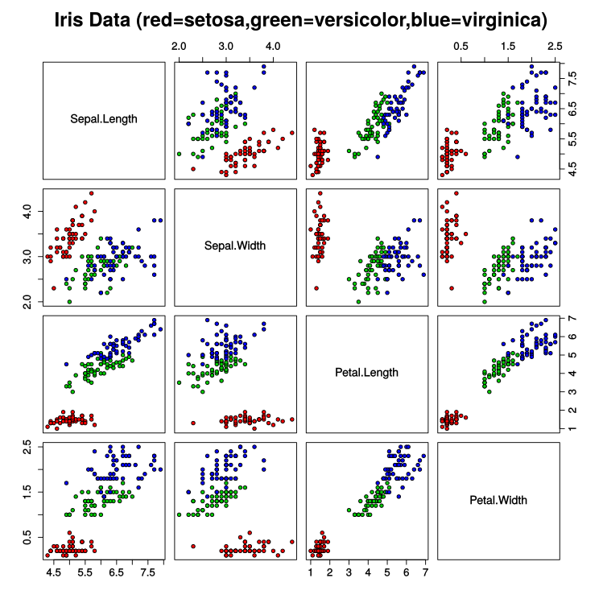
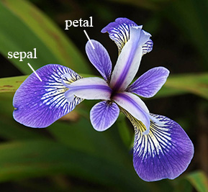
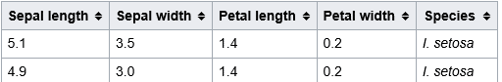
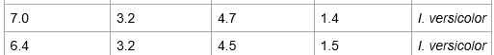
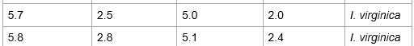
Example: Iris Classification
Scatter Plot
Dataset 4 Features + Label
sample
features
labels
Notes:
Machine Learning is about extracting knowledge from data. It is based on probability theory.
Machine Learning is a subset of Artificial Intelligence.

Slide 16
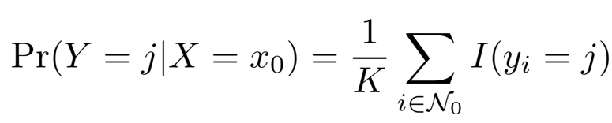
Iris Classification: k-Nearest Neighbors (KNN)
Use the largest fraction of the data (e.g. 80%) for “training the model”
Select training samples randomly
Just store the training sample
Use the rest of the data for testing the model
Predict that the test sample belongs to the same species as the k nearest neighbors of the training data set
More formally, determine the probability that a sample belongs to a particular class using the following formula:
Then select the class that maximizes the above formula.

Slide 17
Main Categories of Machine Learning
Supervised Learning:
The training data contains the desired predicted or classified values (so-called labels)
Unsupervised Learning:
The training data does not contain any labels. The system tries to learn without any guidance
Semi-Supervised Learning:
A combination of Supervised and unsupervised learning. Some labels are provided
Reinforcement Learning:
The system (“agent”) learns the best strategy (“policy”) that maximizes a reward function by observing the environment and selecting and performing actions

Slide 18
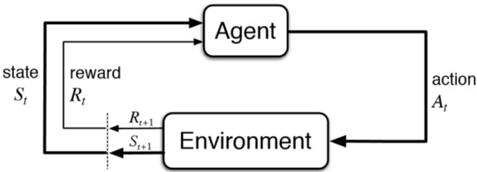
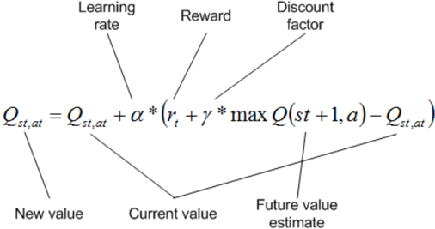
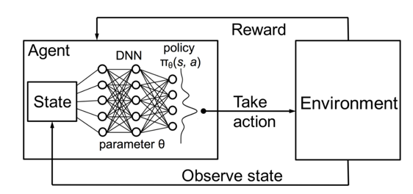
Reinforcement Learning

Slide 19
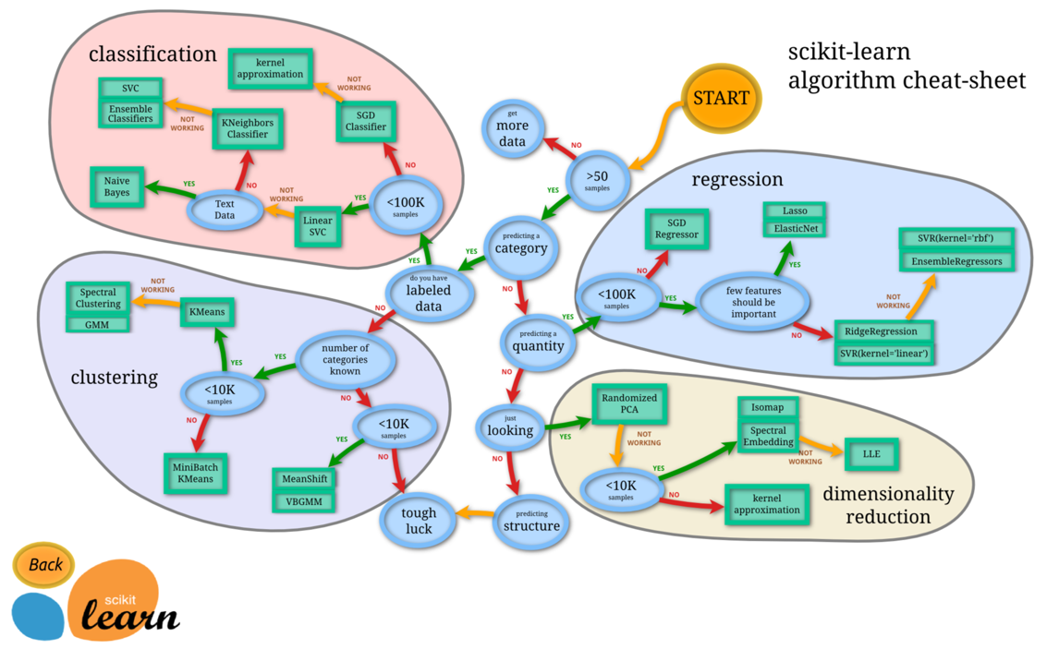
How to select the right algorithm? (The cheat sheet below may not be of much use.)

Slide 20
A Classification of Some ML Algorithms
Machine Learning
Supervised Learning
Unsupervised
Learning
Regression
Cluster Analysis
Dimensionality Reduction
Classification
SVM
Decision Trees
Linear Regression
Hierarchical Clustering
PCA
t-SNE
K-Means
KNN
Logistic Regression

Slide 21
Algorithms for Supervised Learning (Regression/Classification)
Linear Regression (incl. Polynomial Regression)
Logistic Regression
K-nearest Neighbors
Support Vector Machines
Naïve Bayes (Classifier/Regression)
Decision Trees, Random Forest, XGBoost
Deep Learning (NN, CNN, RNN, …)

Slide 22
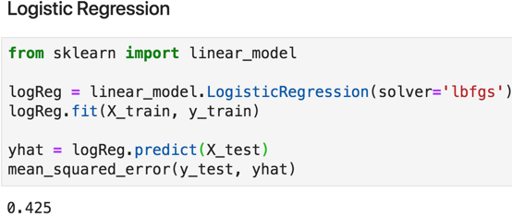
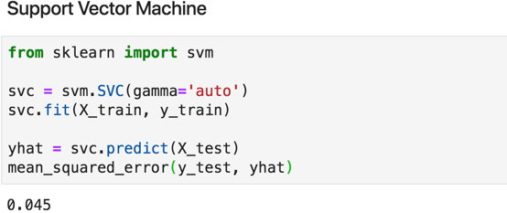
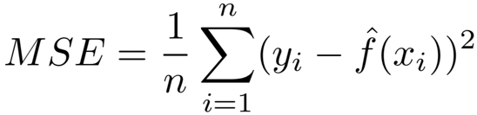
Do we really need to learn that many algorithms?
Mean Squared Error

Slide 23
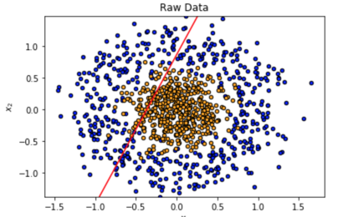
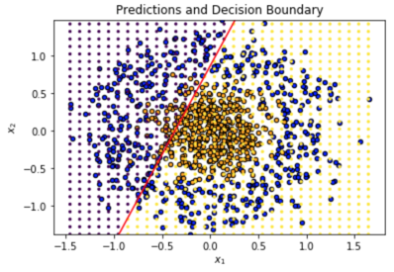
LR Decision Boundary

Slide 24
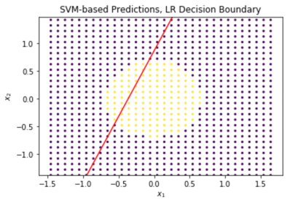
SVM Predictions

Slide 25
Machine Learning Concepts
Before looking at individual algorithms, let’s have a look at some high-level machine learning concepts. We start with just a few and will add more throughout the training. We will explore the concepts in detail during the exercises.

Slide 26
Supervised Machine Learning
Training Data
Model
Training
Training Labels
Test Data
Prediction
Generalization
Test Labels
Evaluation

Slide 27
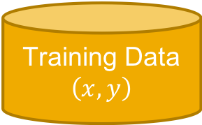
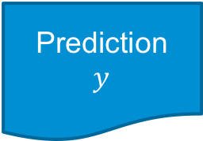
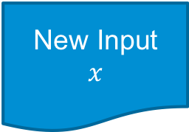
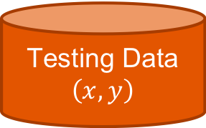
Simplified ML workflow
Training / Modeling
Training Data
$$\left(x, y\right)$$
Learning Algorithm
Model
Testing / Evaluation
Testing Data
$$\left(x, y\right)$$
Model
Accuracy Estimate
Deployment
New Input
$$x$$
Model
Prediction
$$y$$

Slide 28
Machine Learning Concepts: Generalization (Supervised Learning)
Learning requires Generalization
A system is trained on (labeled) training data, and evaluated on (labeled) test data.
If a system does not perform well on the training data, then the algorithm has a high bias and is underfitting the data. A system that performs well on the training data, but not on the test data failed to generalize what it learned. Such an algorithm has a high variance and is overfitting the data.
There is generally a tradeoff between bias and variance, but that does not mean that you should try to minimize both bias and variance.
Overfitting may be reduced by choosing an algorithm that has a lower variance, by increasing the training set, or by regularization. The latter will be discussed when we explore specific ML algorithms.

Slide 29
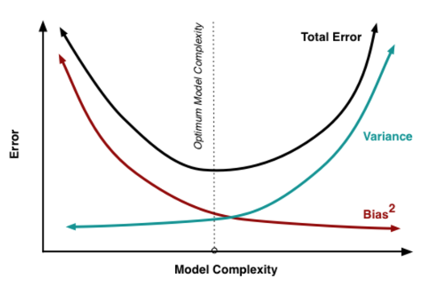
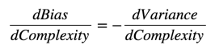
Bias and Variance
“The sweet spot for any model is the level of complexity
at which the increase in bias is equivalent to the reduction
in variance.”
Source: http://scott.fortmann-roe.com/docs/BiasVariance.html

Slide 30
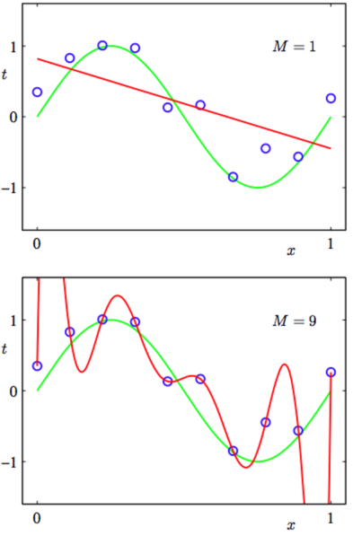
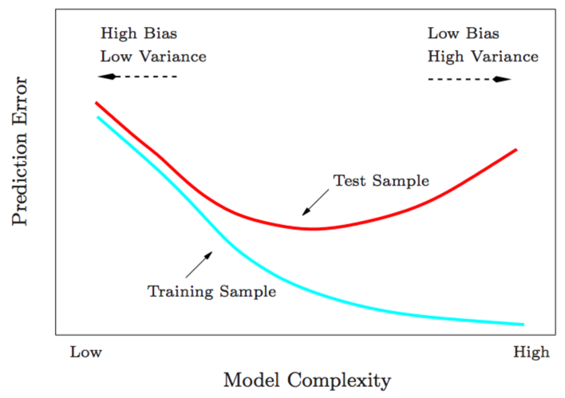
Bias and Variance

Slide 31
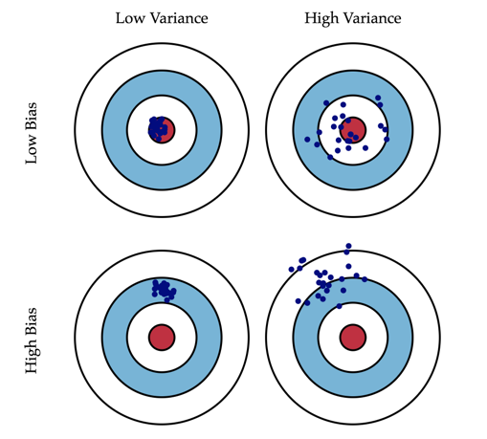
Bias and Variance
Source: http://scott.fortmann-roe.com/docs/BiasVariance.html

Slide 32
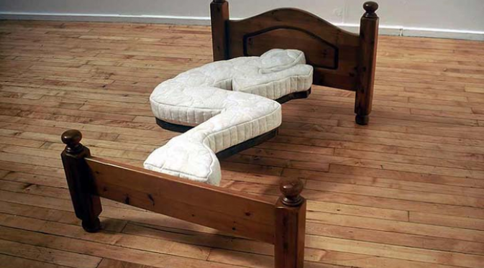
Overfitting

Slide 33
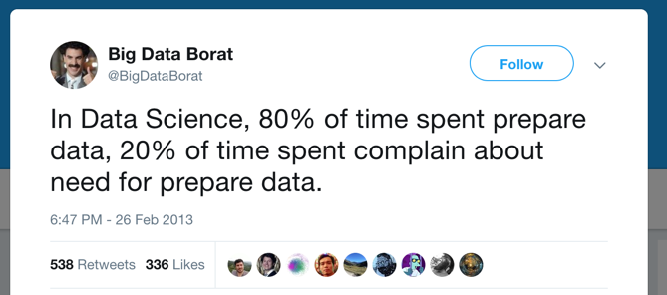
Feature Engineering

Slide 34
Instance-based Models
k-NN – K-Nearest Neighbors
Very poor with noisy data and irrelevant features
Not suitable for very large datasets. (Must “remember” dataset for prediction.)
SVM – Support Vector Machine
(Covered later this week)

Slide 35
Exercises
Notebooks
Python/Numpy Intro (Optional)
Classification using KNN

Slide 36
Machine Learning Concepts: Dimensionality Reduction (Unsupervised Learning)
Another Form of Generalization: Dimensionality/Feature Reduction
While supervised systems learn from labeled instances and need to generalize to predict/classify unseen data, unsupervised systems often ”learn” by summarizing the data or by transforming the data to a lower dimension.
Examples:
Principle Component Analysis (PCA): Reduce the number of dimensions by eliminating those that have the lowest variance. In other words, the data is projected to a lower-dimensional subspace. Example use-case: Image compression.
Clustering: By labeling individual examples, we “reduce” the examples to the properties of the cluster they are assigned to. Business example: customer segmentation, i.e. we devise an identical strategy for every customer belonging to the same segment.

Slide 37
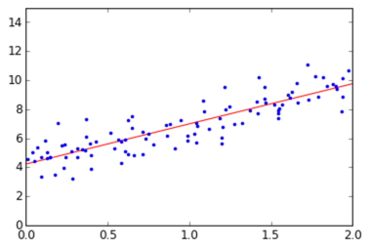
Similarities between Generalization and Dimensionality Reduction
Example: Linear Regression
Linear regression can be interpreted as projecting the data set to a lower dimension. In the diagram, we reduce the dimension from 2 to 1 by projecting the points in the plane to a line.

Slide 38
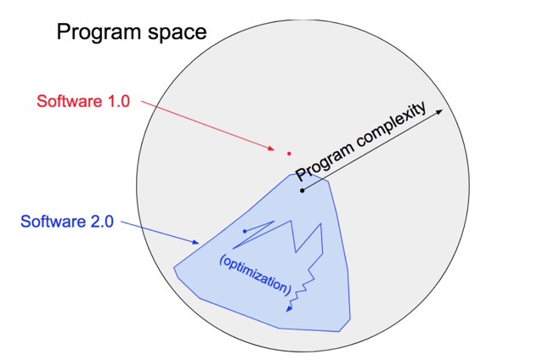
Software 2.0 / Differentiable Programming
Source: https://medium.com/@karpathy/software-2-0-a64152b37c35
Kunle-ISCA-Keynote-2018.pdf

Slide 39
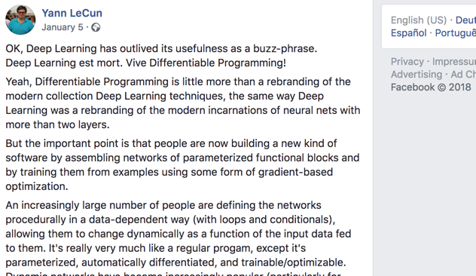
Software 2.0 / Differentiable Programming

Slide 40

Software 2.0 / Differentiable Programming
To all Scala/Haskell developers:
Check out Automatic Functional Differentiation
Automatic differentiation is composable! You can implement it as a monad (with the chain rule as flatMap).

Slide 41
More Concepts – High-level Overview
Linear Models
Objective Function / Loss Function
Regularization
Feature Engineering
Normalization
Test-Training, Test-Training-Validation, Cross-Validation

Slide 42
Training Environment
[Moved to separate slide deck.]

Slide 43
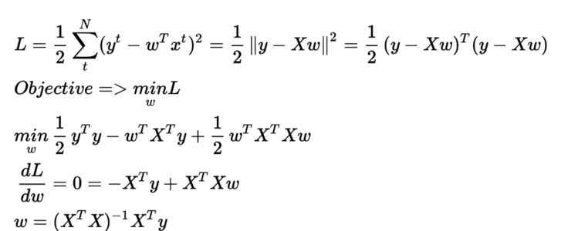
Linear Regression: Closed Form

Slide 44
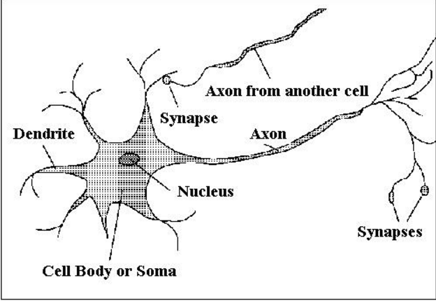
Neuron
Many inputs / one output
Output can be excited or not excited depending on the incoming signals from other neurons (and several other factors)

Slide 45
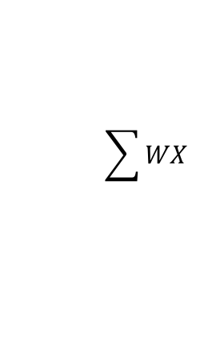
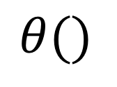
Perceptron
Bias
b
x₁
w₁
Activation
function
Output
y
Input
signal
x₂
w₂
$$\sum{WX}$$
$$θ()$$
T
x_{m}
w_{m}
T

Slide 46
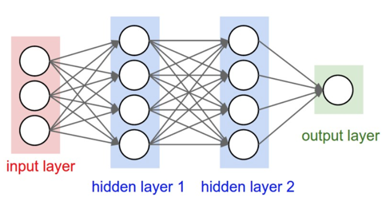
Deep Neural Network

Slide 47
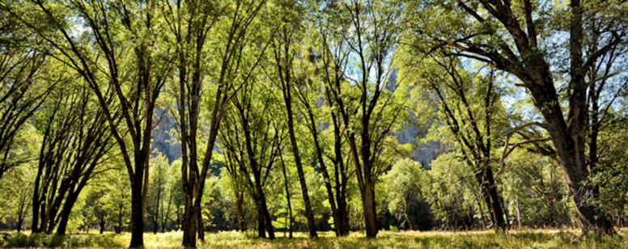
Decision Trees

Slide 48
Decision Trees (CART)
Intuitive: Easy to understand and interpret
Minimal data preparation:
Since only one feature is considered at a time, normalization is not required
Performance (Prediction) is logarithmic in the number of data points used to train the tree
Can handle both numerical and categorical data
White box model, i.e. data is easy to interpret
Possible to validate a model using statistical tests

Slide 49
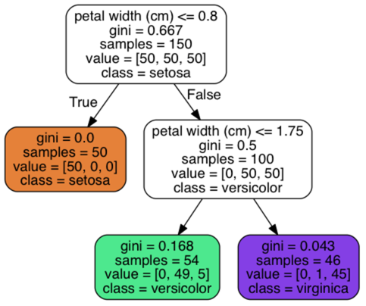
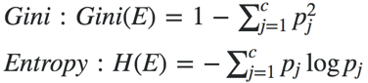
Decision Trees (CART)
Binary Tree
Internal Nodes: Question on a single feature, such as “petal length <= 2”
Leaf Nodes: Contains class label, determined by majority vote of training examples reaching the leaf
Samples: The number of training examples the node represents
Value: Distribution of training examples by class
Class: Determined by majority vote
Impurity measure: Gini or Entropy
Here we are using Gini
Value 0: All training examples belong to the same class
Example, bottom-left node:
Distribution: [0, 49, 5], Samples: 54 -> Gini = 1 – (0/54)^2 – (49/54)^2 – (5/54)^2 = 0.168

Slide 50
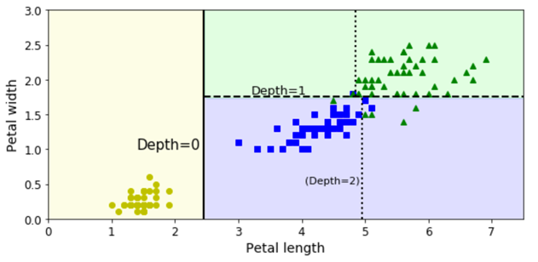
Decision Tree Boundaries
Vertical Line: Decision Boundary of root node: petal length = 2.45
Left area is pure (Gini=0, all examples are of type setosa, so no further splits
Right area, horizontal line: petal width = 1.75, further splits needed (Gini = 0.5)
(max_depth = 2)

Slide 51
“Growing the tree” – CART Algorithm
Idea: Split training set into two subsets using a single feature k and a threshold t_{k} (e.g. k = petal width, t_{k} = 1.75)
Choice of k, t_{k}: Find the pair (k, t_{k}) that produces the purest subsets (based on Gini impurity or Entropy)
Cost Function: J(k, t_{k}) = (m_{left} / m) * G_{left} + (m_{right} / m) * G_{right}
G_{left/right}: Impurity of the left/right subset
m_{left/right}: Number of instances in the left/right subset
The algorithm splits the subsets recursively using the same logic until the maximum depth is reached (max_depth hyperparameter),
or it cannot find a split that reduces impurity.
Differences between Gini impurity and Maximum Entropy
Both lead to very similar results, ME is slightly slower
Gini tends to isolate the most frequent class in its own branch
ME may lead to slightly more balanced trees

Slide 52
Disadvantages of Decision Trees
Overfitting: The trees can be very complex and do not generalize the data well.
Small variations in the data might result in a completely different tree being generated.
The learning of an optimal decision tree is NP-complete, so heuristic algorithms (e.g. greedy algorithm) is used. An optimal decision is made at each node, but a globally optimal decision tree cannot be guaranteed.
Since a split is only based on one feature at a time, certain functions (e.g. XOR) cannot be expressed easily

Slide 53
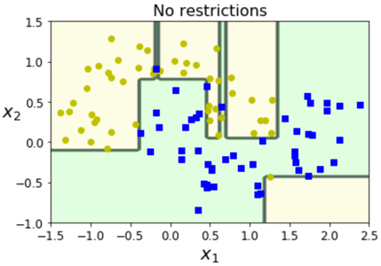
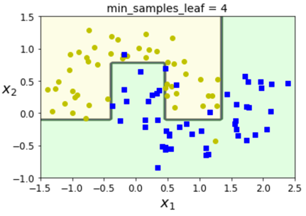
Regularization Hyperparameters
A decision tree model is nonparametric, so it is free to fit the training data very closely which often leads to overfitting.
To avoid overfitting, we often have to restrict (regularize) the model (i.e. increase the bias)
max_depth (maximum depth of the tree)
min_samples_split (minimum number of samples a node must have before it can split)
min_samples_leave (minimum number of samples a leave node must have)
max_leave_nodes (maximum number of leave nodes)
…
The model is regularized by increasing the min_xxx parameters and decreasing the max_xxx parameters.

Slide 54

Ensemble Methods

Slide 55
Ensemble Methods
An ensemble method often provides good results (“strong learner”) even if the individual classifiers perform just slightly better than random guessing (“weak learner”) – provided that
there are a sufficient number of weak learners and
the weak learners are diverse (ideally, the should be independent of each other)
Hard-Voting Classifier
Train several classifiers
Aggregate the predictions of each classifier and predict the class that gets the most votes
Soft-Voting Classifier
Train several classifiers that can provide a class probability
Predict the class with the highest class probability averaged over all the individual classifiers

Slide 56
Bagging and Pasting / Random Features and Subspaces
Instead of using different algorithms, train the same algorithm on different random subsets of the training set.
Bagging (Bootstrap Aggregation): Sampling is performed with replacement
Pasting (less common): Sampling is performed without replacement
Bagging allows training instances to be sampled several times for the same predictor.
An ensemble method based on bagging has a similar bias as a classifier trained on the entire dataset, but its variance is lower.
Out-of-Bag Evaluation: Since not all training instances are sampled for each predictor, the remain ones (so-called out-of-bag instance) can be used for validation. This eliminates the need for keeping a separate validation set or using cross-validation.
Random Features: Sample the features of the datasets in addition to the training instances.
Random Subspaces: Sample the features, but use all training instances.

Slide 57
Random Forest
A random forest is an ensemble of decision trees and utilizes
Bagging (bootstrap aggregation)
A random subset of features (typically √p for classification; n/3 (but not fewer than 5) for regression)
Train all trees independently of each other.
The final prediction is obtained by majority voting (in case of classification)
or by averaging the predictions (in case of regression).

Slide 58
Random Forest / Extra-Trees
All regularization parameters that are available for decision trees apply (though they tend to be applied more aggressively).
Since individual trees are based on different random subsets, the nodes are split differently (both on different features and thresholds). Thus, the individual classifiers are more diverse, and the ensemble has a lower variance.
Random forest does not perform well if the features are dependent of each other or if you have more features than samples. If this is the case (or if you are not sure), reduce the number of features by applying PCA.
Extra-Trees: Instead of selecting the best threshold, use random thresholds in order to make the individual trees even more diverse. The is called extremely randomized trees (or “extra-trees”).

Slide 59
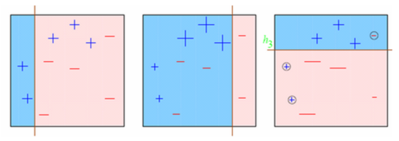
Boosting
Like bagging, boosting is an ensemble method that combines several (weak) learners.
Instead of using majority voting, the (weak) learners are combined in sequence, where (typically) each subsequent classifier is trying to correct the mistakes of its predecessor.
AdaBoost: The weights of the previously misclassified training instances are increased, so the subsequent classifier can focus more on the hard cases.
(For a very gentle introduction, see https://www.youtube.com/watch?v=gmok1h8wG-Q )

Slide 60
Gradient Boosted Decision Trees
Instead of increasing the weights of previously misclassified samples after each iteration, the subsequent classifier/regressor tries to predict the residual errors of its predecessor.
Example:
from sklearn.tree import DecisionTreeRegressor
tree1 = DecisionTreeRegressor(max_depth=2)
tree1.fit(X, y) #Train first decision tree
y2 = y – tree1.predict(X)
tree2 = DecisionTreeRegressor(max_depth=2)
tree2.fit(X, y2) # Train the second decision tree on the residual error of the first predictor
y3 = y2 – tree2.predict(X)
tree3 = DecisionTreeRegressor(max_depth=2)
tree3.fit(X, y3) # Train the third decision tree on the residual error of the second predictor
y_hat = sum(tree.predict(X_Test) for tree in (tree1, tree2, tree3)
Or simpler:
from sklearn.ensemble import GradientBoostingRegressor
gboost = GradientBoostingRegressor(max_depth=2, n_estimators=3, learning_rate=1.0)
gboost.fit(X, y)

Slide 61
Gradient Boosted Decision Trees
Unlike random forest (which requires very little tuning), GBDTs are prone to overfitting and require the careful tuning of various hyperparameters.
Since every new tree corrects the residual errors of its predecessor, the model can very quickly end up overfitting the training set.
The learning can be slowed down by applying a weighting factor to the subsequently added trees. The weighting factor is controlled by the learning rate (also called shrinkage factor).
Values less than 1.0 lead to fewer corrections of each newly added tree. As a consequence, more trees need to be added. Good values may be in the range of 0.1 – 0.3, sometimes even below 0.1.

Slide 62
XGBoost
Tip:
While scikit-learn supports gradient boosted decision trees, there is one implementation (with a Python and R API) that performs much better. It’s called XGBoost
http://xgboost.readthedocs.io/en/latest/
So if you plan to win Kaggle competitions, make sure you have XGBoost in your toolbox. (Also, be prepared to spend a lot of time on parameter tuning.)
http://blog.kaggle.com/2017/01/23/a-kaggle-master-explains-gradient-boosting/

Slide 63
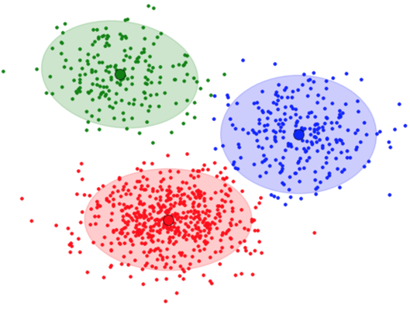
Unsupervised Learning – K-Means Clustering

Slide 64
K-Means Clustering
Separate (unlabeled) samples into k groups by trying to minimize within-cluster sum-of-squares
Number of clusters need to be specified
Each group is defined my the mean of the samples in the cluster
The mean of a cluster is called a centroid.
Obviously, a centroid is (most probably) not a point of the original dataset. If this is required, there is a variation of k-means, called k-medoids which always selects centroids from the original dataset.
Another variation of k-means is k-medians, which uses the median as a centroid, i.e. the error is minimized according to the 1-norm distance metric instead of the square of the 2-norm distance metric

Slide 65
Cluster Analysis – Partitioning Algorithms
Distance-based method:
Partitioning algorithms: K-Means, K-Medians, K-Medoids
Distance between two data objects
Rules:
A cluster is a collection of data objects that are:
High intra-class similarity: Similar to one another within the same cluster.
Low inter-class similarity: Dissimilar to the objects in other groups, i.e. clusters.
Weights
Heights

Slide 66
K-means Algorithm
Step 0: (Initialization)
Randomly select k centroids (generate or select from dataset)
Step 1: (Assignment)
Each sample is assigned to the its closest centroid (based on the Euclidean distance)
Step 2: (Update of Centroids)
For each cluster (= samples assigned to the same centroid), the centroid becomes the mean of the samples
Iterate between steps 1 and 2 until a stopping criterion is reached, e.g.
Maximum number of iterations is reached
Samples are no longer reassigned to different clusters

Slide 67
K-means Algorithm
The k-means algorithm is guaranteed to converge. However, since the initial centroids where chosen randomly, the result is often a local minimum
Consequently, the algorithm is run several times (with different initializations of the centroids)
To determine the optimal number of k, the algorithm is run for a range of k values
The is no obvious best choice for k. By increasing k, the within-cluster some of square is decreasing (and eventually reaches zero)

Slide 68
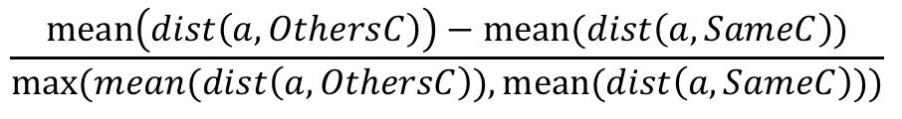
Evaluating the Quality of the Result
Silhouette Coefficient:
Checks cluster cohesion and separation together.
K = 3
$$dist\left(a,OthersC\right)= distance of \text{a} from data objects of other cluster$$
Weights
a
c3
$$dist\left(a,SameC\right)= distance of \text{a} from data objects of same cluster$$
c1
c2
Silhouette Coefficient for a, =
a
$$\frac{mean\left(dist\left(a,OthersC\right)\right)−mean(dist\left(a,SameC\right))}{max⁡(mean(dist\left(a, OthersC\right)),mean(dist\left(a,SameC\right)))}$$
Heights

Slide 69
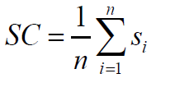
Cluster Analysis – Partitioning Algorithms – K Means
Silhouette Coefficient:
Checks cluster cohesion and separation together.
K = 3
Weights
c3
c1
c2
SC is complete Silhouette Coefficient
is Silhouette Coefficient of i^{th} data object
n is total number of data objects
SC close to one 1 implies good clustering.
Heights

Slide 70
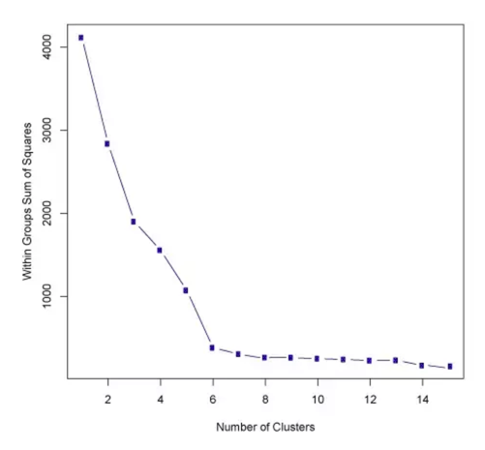
Elbow Method

Slide 71
K-Means++
Since the initialization has a major impact on the quality of the result (local vs. global minimum), an improved algorithm, K-means++ should be used. (Scikit-learn is using k-means++ by default; init='k-means++’).
See k-means++ Wikipedia entry (and references) for more details:
K-means++ Initialization
Choose one center uniformly at random from among the data points.
For each data point x, compute D(x), the distance between x and the nearest center that has already been chosen.
Choose one new data point at random as a new center, using a weighted probability distribution where a point x is chosen with probability proportional to D(x)².
Repeat Steps 2 and 3 until k centers have been chosen.
Now that the initial centers have been chosen, proceed using standard k-means clustering

Slide 72
K-means – Other Considerations
Data normalization is key to getting sensible results!
Understand the data before running k-means: K-means is pretty useless is the clusters are elongated, manifolds with irregular shapes, etc.
Use a parallel algorithm. Also, distributed compute environments (e.g. Apache Spark) make it very easy to run multiple parallel instances of k-means (for different k’s and initializations)
K-means could be useful to enhance classification tasks (at least for samples where convex clusters can be assumed to exist)
Consider PCA to reduce dimensionality!
http://scikit-learn.org/stable/auto_examples/cluster/plot_kmeans_digits.html

Slide 74
Backup

Slide 75
Cluster Analysis – How?
How many clusters?
What is the criteria to form clusters?
Weights
Heights

Slide 76
Cluster Analysis – Solution
Distance-based methods:
Partitioning algorithms: K-Means, K-Medians, K-Medoids (details will follow).
Hierarchical algorithms: Agglomerative versus divisive methods (no details in this PPT).
Weights
Heights

Slide 77
Cluster Analysis – Similarity and Dissimilarity
Similarity measure or similarity function: A real-value function that quantifies the similarity between two objects.
Measure how two data objects are alike: The higher value, the more alike.
Often falls in the range [0,1]: 0: No similarity; 1: Completely similar
Dissimilarity (or distance) measure: Numerical measure of how different two data objects are.
In a way, the inverse of similarity: The lower, the more alike.
Minimum dissimilarity is often 0 (i.e., completely similar).
Range [0, 1] or [0, ∞) , depending on the definition.
Proximity usually refers to either similarity or dissimilarity.

Slide 78
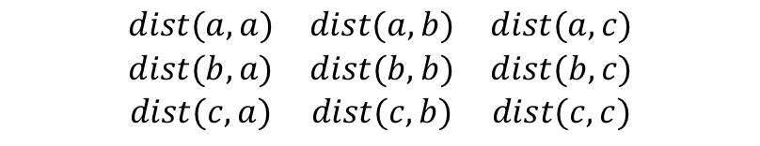


Cluster Analysis – Partitioning Algorithms – Distance Matrix
Distance Matrix
c
$$\begin{matrix}dist(a,a) & dist(a,b) & dist(a,c) \\ dist(b,a) & dist(b,b) & dist(b,c) \\ dist(c,a) & dist(c,b) & dist(c,c)\end{matrix}$$
Weights
b
How to calculate $dist$ ??
a
$dist(a,c)$ = ??
Heights

Slide 79





Cluster Analysis – Partitioning Algorithms – Distance Matrix
Distance Matrix
$$\begin{matrix}dist(a,a) & dist(a,b) & dist(a,c) \\ dist(b,a) & dist(b,b) & dist(b,c) \\ dist(c,a) & dist(c,b) & dist(c,c)\end{matrix}$$
c
(5.8,5)
$$dist(a,c)$$
Weights
(6,4)
$dist(a,c)$ =
b
a
(2,3)
Euclidean Distance
Manhattan Distance
Where Ha and Hc is Height of a and c
Wa and Wc is Weight of a and c
Heights

Slide 80
Cluster Analysis – Partitioning Algorithms – Manhattan Distance
Distance Matrix
$$\begin{matrix}dist(a,a) & dist(a,b) & dist(a,c) \\ dist(b,a) & dist(b,b) & dist(b,c) \\ dist(c,a) & dist(c,b) & dist(c,c)\end{matrix}$$
c
$$dist(a,c)$$
Weights
| 3 – 5 |
$dist(a,c)$ =
b
a
| 2 – 5.8 |
Manhattan Distance
| 2 – 5.8 |
+
| 3 – 5 |
Where Ha and Hc is Height of a and c
Wa and Wc is Weight of a and c
Heights

Slide 81


Cluster Analysis – Partitioning Algorithms – Euclidean Distance
Distance Matrix
$$\begin{matrix}dist(a,a) & dist(a,b) & dist(a,c) \\ dist(b,a) & dist(b,b) & dist(b,c) \\ dist(c,a) & dist(c,b) & dist(c,c)\end{matrix}$$
c
Weights
$$\sqrt{{\left(2−5.8\right)}^{2}+{\left(3−5\right)}^{2}}$$
$dist(a,c)$ =
b
a
Euclidean Distance
$$\sqrt{{\left(2−5.8\right)}^{2}+{\left(3−5\right)}^{2}}$$
Where Ha and Hc is Height of a and c
Wa and Wc is Weight of a and c
Heights

Slide 82
Cluster Analysis – Partitioning Algorithms – Distance matrix
Distance Matrix
$$\begin{matrix}dist(a,a) & dist(a,b) & dist(a,c) \\ dist(b,a) & dist(b,b) & dist(b,c) \\ dist(c,a) & dist(c,b) & dist(c,c)\end{matrix}$$
c
$$dist(a,c)$$
Weights
b
What if heights and weights are categorical??
For example,
Height: Tall, small, very small, too tall etc.
Weight: Light, heavy, very light, very heavy etc.
a
Heights

Slide 83



Cluster Analysis – Partitioning Algorithms – Distance Matrix
Distance Matrix
c
$$\begin{matrix}dist(a,a) & dist(a,b) & dist(a,c) \\ dist(b,a) & dist(b,b) & dist(b,c) \\ dist(c,a) & dist(c,b) & dist(c,c)\end{matrix}$$
$$dist(a,c)$$
Weights
b
What if heights and weights are categorical?
For example,
Height: Tall, small, very small, too tall etc.
Weight: Light, heavy, very light, very heavy etc.
a
Heights
Solution:
$dist(a,c)$ =
$$\frac{Total number of categorical variables −matched variables}{Total number of categorical variables}$$

Slide 84










Cluster Analysis – Partitioning Algorithms – Distance Matrix
Distance Matrix
Height_ Status | Sex | Salaried | Married
Tall | Male | Yes | Yes
Tall | Female | Yes | No
$$\begin{matrix}dist(a,a) & dist(a,b) & dist(a,c) \\ dist(b,a) & dist(b,b) & dist(b,c) \\ dist(c,a) & dist(c,b) & dist(c,c)\end{matrix}$$
$$a$$
$$c$$
$$Matched$$
$$Yes$$
$$No$$
$$Yes$$
$$No$$
Solution:
$dist(a,c)$ =
$$\frac{Total number of categorical variables −matched variables}{Total number of categorical variables}$$
$$\text{=} \frac{4 −2}{4}$$

Slide 85
Cluster Analysis – Partitioning Algorithms – Distance matrix
Distance Matrix
c
$$\begin{matrix}dist(a,a) & dist(a,b) & dist(a,c) \\ dist(b,a) & dist(b,b) & dist(b,c) \\ dist(c,a) & dist(c,b) & dist(c,c)\end{matrix}$$
$$dist(a,c)$$
Weights
b
a
What if only heights is categorical but weight is continuous?
Heights

Slide 86

Cluster Analysis – Partitioning Algorithms – Distance Matrix
Distance Matrix
$$\begin{matrix}dist(a,a) & dist(a,b) & dist(a,c) \\ dist(b,a) & dist(b,b) & dist(b,c) \\ dist(c,a) & dist(c,b) & dist(c,c)\end{matrix}$$
c
$$dist(a,c)$$
Weights
What if only heights is categorical but weight is continuous?
b
Solution:
a
$dist(a,c)$ =
Euclidean Distance for continuous variables
+
Heights
$$\frac{Total number of categorical variables −matched variables}{Total number of categorical variables}$$

Slide 87

Cluster Analysis – Partitioning Algorithms – K Means
Partitional clustering approach.
Each cluster is associated with a centroid (center point).
Each point is assigned to the cluster with the closest centroid.
Number of clusters, K, must be specified.
The basic algorithm is very simple.

Slide 88

K –Means Example
Click here to see K-Means animation

Slide 89
Cluster Analysis – Partitioning Algorithms – K Means
K = 3
Weights
Heights

Slide 90
Cluster Analysis – Partitioning Algorithms – K Means
K = 3
c3
Randomly select three data objects as center of three clusters.
Weights
c2
c1
Heights

Slide 91
Cluster Analysis – Partitioning Algorithms – K Means
Learning starts here:
K = 3
c3
Get distances from each data object to center c1.
Weights
c2
c1
Heights

Slide 92
Cluster Analysis – Partitioning Algorithms – K Means
Learning starts here:
K = 3
c3
Get distances from each data object to center c2.
Weights
c2
c1
Heights

Slide 93
Cluster Analysis – Partitioning Algorithms – K Means
Learning starts here:
K = 3
c3
Get distances from each data object to center c3.
Weights
c2
c1
Heights

Slide 94
Cluster Analysis – Partitioning Algorithms – K Means
Learning starts here:
K = 3
c3
Assign Data object to the cluster which have the minimum distance among center c1, c2, c3.
Weights
c2
Use distance matrix.
c1
Heights

Slide 95
Cluster Analysis – Partitioning Algorithms – K Means
Learning starts here:
K = 3
c3
Assign Data object to the cluster which have the minimum distance among center c1, c2, c3
Weights
c2
Use distance matrix
c1
Winner
Heights

Slide 96
Cluster Analysis – Partitioning Algorithms – K Means
Learning continues:
K = 3
Find a best center position that fulfills cluster criteria.
c3
Weights
How to find it?
c2
c1
Heights

Slide 97



Cluster Analysis – Partitioning Algorithms – K Means
K = 3
Find a best center position that fulfills cluster criteria.
c3
Weights
Apply statistics, below is the cost function:
c2
c1
SSE(C) is sum of squared error
Heights
is kth cluster
is ith data object

Slide 98
Cluster Analysis – Partitioning Algorithms – K Means
K = 3
Find a best center position that fulfills cluster criteria.
c3
Weights
Apply statistics, below is the cost function:
c2
c1
Heights
Goal : Minimize this function

Slide 99



Cluster Analysis – Partitioning Algorithms – K Means
K = 3
c3
Weights
c2
$$\frac{dSSE(C)}{dc}$$
$$\frac{Change in SSE(C)}{Change in center position c}$$
c1
Heights

Slide 100








Cluster Analysis – Partitioning Algorithms – K Means
K = 3
Weights
c3
$$\frac{dSSE(C)}{dc}$$
$$\frac{Change in SSE(C)}{Change in center position c}$$
c1
c2
$$\frac{dSSE(C)}{dc}$$
= 0, and solve.
$$\frac{1}{n}$$
$$\sum{x}$$
Heights
$$New center c$$
=

Slide 101
Cluster Analysis – Partitioning Algorithms – K Means
K = 3
Cluster Quality?
Weights
c3
c1
c2
Heights

Slide 102
Cluster Analysis – Partitioning Algorithms – K Means
K = 3
Silhouette Coefficient:
Checks cluster cohesion and separation together.
Weights
c3
c1
c2
Heights

Slide 103


Cluster Analysis – Partitioning Algorithms – K Means
Silhouette Coefficient:
Checks cluster cohesion and separation together.
K = 3
$$dist\left(a,OthersC\right)= distance of \text{a} from data objects of other cluster$$
Weights
a
c3
$$μ=mean$$
$$dist\left(a,SameC\right)= distance of \text{a} from data objects of same cluster$$
min: minimum
max: maximum
c2
c1
Silhouette Coefficient for a, =
a
$$\frac{min⁡(μ\left(dist\left(a,OthersC\right)\right))−μ(dist\left(a,SameC\right))}{max⁡(\min\left(μ\left(dist\left(a,OthersC\right)\right)\right),μ(dist\left(a,SameC\right)))}$$
Heights

Slide 104
Cluster Analysis – Partitioning Algorithms – K Means
Silhouette Coefficient:
Checks cluster cohesion and separation together.
K = 3
Weights
c3
c1
c2
SC is complete Silhouette Coefficient
is Silhouette Coefficient of ith data object
n is total number of data objects
Heights

Slide 105
Cluster Analysis – Partitioning Algorithms – K Means
Silhouette Coefficient:
Checks cluster cohesion and separation together:
K = 3
Weights
c3
c1
c2
SC close to one 1 implies good clustering.
Heights

Slide 106
Cluster Analysis – Partitioning Algorithms – K Means
Limitations and Challenges:
K-means clustering often terminates at a local optimal Initialization can be important to find high-quality clusters
Which one is best clusters formation?
Weights
Weights
Heights
Heights

Slide 107
Cluster Analysis – Partitioning Algorithms – K Means
Limitations and Challenges:
K-means clustering often terminates at a local optimal Initialization can be important to find high-quality clusters.
Which one is best clusters formation?
This one
Weights
Weights
Heights
Heights

Slide 108
Cluster Analysis – Partitioning Algorithms – K Means
Limitations and Challenges:
Need to specify K, the number of clusters, in advance. There are ways to automatically determine the “best” K.
In practice, one often runs a range of values and selects the “best” K value.
Sensitive to noisy data and outliers Variations: Using K-medians, K-medoids, etc.

Slide 109

Cluster Analysis – Partitioning Algorithms – K Means
Limitations and Challenges:
Not suitable to discover clusters with non-convex shapes using density-based clustering, kernel K-means, etc.
Weights
Heights

Slide 110

Cluster Analysis – Partitioning Algorithms – K Means
Limitations and Challenges:
Not suitable to discover clusters with non-convex shapes.
Possible solutions: Using density-based clustering, kernel K-means, etc.
After applying K Means
Weights
Heights

Slide 111

Decision Trees (CART) - Regression
Binary Tree
Internal Nodes: Question on a single feature, such as “petal length <= 2”
Leaf Nodes: Contains class label, determined by majority vote of training examples reaching the leaf
Samples: The number of training examples the node represents
Value: Distribution of training examples by class
Class: Determined by majority vote
Impurity measure: Gini or Entropy
Here we are using Gini
Value 0: All training examples belong to the same class
Example, bottom-left node:
Distribution: [0, 49, 5], Samples: 54 -> Gini = 1 – (0/54)^2 – (49/54)^2 – (5/54)^2 = 0.168

Slide 112
Thank you
Contact information:
F name L name
Title
Address
Phone number
F name L name
Title
Address
Phone number

